Slide 1



Utah Coordinating Council for Youth in Custody
Trina M. Valdez Department of Human Services
Bridget Koza Administrative Office of the Courts
Steve Kaelin Utah State Board of Education
Kyle Goudie Division of Juvenile Justice Services
Tanya Albornoz Division of Child & Family Services

Slide 2

Executive summary
Millions of students experience educational disruptions in the U.S. each year; for many, the burden and impact is magnified by fragmentation of the support system meant to help them overcome challenges. This often results in significant, negative effects on life trajectories.
Fragmentation is prevalent across Utah’s education system, where there is little formal coordination among agencies and support organizations. As a result, consistent use of program resources and accountability around a single set of goals is lacking, causing:
  Access to resources/supports and student experiences to be unequal and inequitable across districts
  The cost of direct supports for students in a fragmented system to create a financial burden on the state
The Utah State Board of Education’s Youth in Care Program (YIC) oversees education for students in custody across the state. The state department of education contracts with local school districts to implement YIC programs for students in foster care and in juvenile detention. A strong culture of local control means that programs differ significantly across district, which further challenges consistent outcomes and accountability statewide and magnifies the effects of fragmentation.
The Youth in Care program is committed to improving coordination across district sites to ensure enrolled students are consistently prepared to embark on life trajectories equitable to those of the population not in custody.
Leadership has developed a plan that begins with a shared definition of quality statewide:
  Developing a preliminary rubric to define and measure quality
  Working with district leaders to finalize, pilot, and implement the rubric
Once Youth in Care stakeholders have agreed on what quality looks like, program leaders will shift their focus to facilitating equity and accountability across sites.

Slide 3



Disrupted education drives long-term negative outcomes for millions of students nationwide
~5M young people nationwide face trauma and circumstances in their lives that are disruptive to education
To access services needed to overcome disruptions, they often must navigate multiple, fragmented systems of care
This additional burden can magnify the significant, negative effects disruption has on the trajectories of young people

Slide 4




Students may face various life challenges during their youth that disrupt the course of their education
Foster
Care
Early Unplanned or Unwanted Pregnancy
Incarceration
Homelessness
The list above is representative of disruptive experiences, but is not exhaustive — youth may face many other challenges that disrupt their education.

Slide 5

Support agencies help youth overcome disruptions, but fragmentation among them decreases effectiveness
Fragmentation among agencies inhibits each agency's ability to ensure that all young people have access to coordinated services and coherent education pathways
Teachers
Schools
Nonprofits
Government agencies
Faith-based orgs
Community-based orgs
Treatment centers
Social workers
Volunteers
Probation
Mentors
Lawyers & judges
As a result, young people, rather than the system itself, bear the burden of navigating the full universe of adults, programs, policies, and services that support them.

Slide 6




Unaddressed educational disruption can have serious implications for life trajectories into adulthood
Lost Income
(from underemployment)
Increased % of Adult Incarceration
Increased % of Adult Homelessness
Increased % of Long-term Reliance on Public Benefits
The list above is representative of long-term consequences, but is not exhaustive — individuals may depend on other public supports over the course of their lifetime.

Slide 7
How do we define the problem of fragmentation and how do we experience it?
Statewide Responsibility – Local LEA School Services
Multiple moves
Gaps in learning
Transfer of records
Interagency Collaboration –Multiple Agencies Involved

Slide 8
The Utah Coordinating Council for Youth In Custody (UCCYIC) is an advisory panel appointed by the Utah State Board of Education (USBE). The focus of the panel is to plan, coordinate, and recommend budget, policy, and program guidelines for the education and treatment of students in the custody of the Division of Juvenile Justice Services and the Division of Child and Family Services.

Slide 10

UCCYIC
DCFS
DSAMH
DSPD
AOC
USBE
JJS
Tribal
Superintendent
SOC

Slide 13
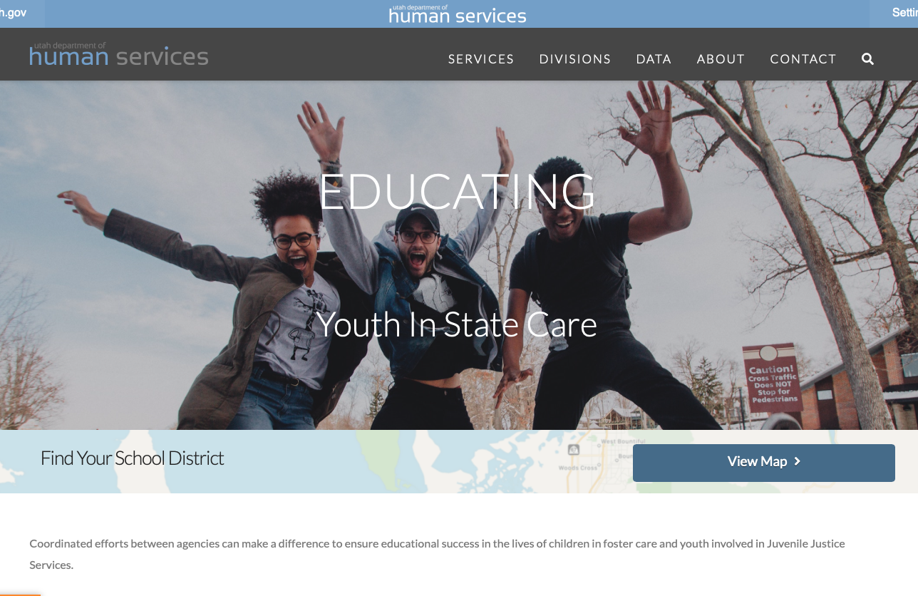
https://hs.utah.gov/education

Slide 14
